Slide 1
Atliq Hospitality Analysis
Ruby Varghese

Slide 2
Agenda
Problem Statement
Visualizations
Insights
Recommendations

Slide 3
Problem Statement
Atliq Grands, a renowned player in the hospitality industry with multiple five-star hotels across India, has been experiencing a decline in market share and revenue within the luxury/business hotels category.
The objective is to address the declining market share and revenue of Atliq Grands in the luxury/business hotels category by leveraging business and data intelligence. Specifically, the goal is to utilize historical data to gain actionable insights that can inform strategic decision-making and enable Atliq Grands to regain its market position.

Slide 4
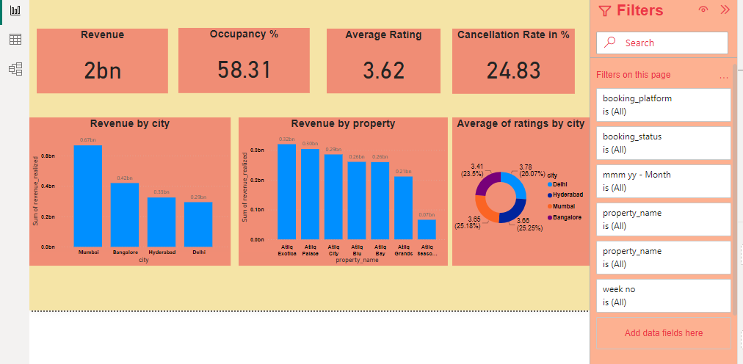

Slide 5
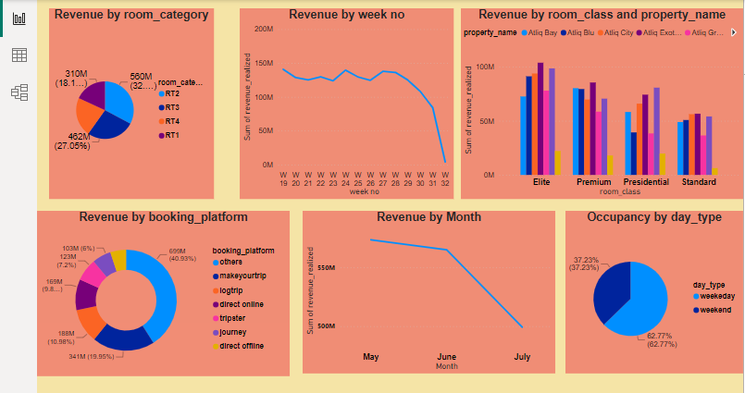

Slide 6
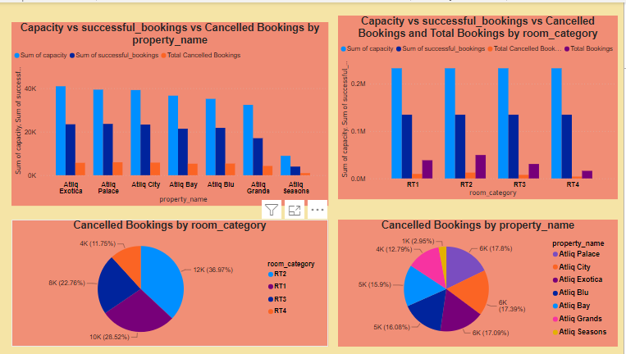

Slide 7
Insights
Total revenue: 2 bn
Average rating: 3.62
Occupancy percentage: 58%
Cancellation rate: 24.83%
Revenue is highest form Mumbai compared to other Cities
Revenue is highest from Atliq Exotica compared to other properties.
Highest revenue is generated in the month of May
Average rating is high for Delhi.
In booking platforms, "others" contribute revenue of 40.93%, followed by “makeyourtrip" contributing 19.95%.
Cancellation rate is more in Atliq Palace(17.8%)

Slide 8
Recommendations
Since revenue is highest from Mumbai compared to other cities, it would be beneficial to allocate resources and marketing efforts to capitalize on this market further. Analyze the factors contributing to this success and try to replicate them in other cities where revenue may be lower.
Revenue is highest from Atliq Exotica compared to other properties, prioritize strategies to maintain and potentially increase revenue from this property. This could include targeted marketing campaigns, enhancing the property's features or services, or offering special promotions to attract more customers.
If the average rating is high for Delhi, it indicates that guests are generally satisfied with their experiences there. To maintain this positive rating, continue to prioritize excellent customer service, cleanliness, and amenities.
Consider collecting feedback from guests to identify areas for improvement and address any issues promptly.

Slide 9
THANK YOU

